Slide 1

Getting started…
Please sit in rows A through J only
Form groups of 3-5 students
Discuss: what are you most confused about?
Post questions on Ask For Me!

Slide 2
Sampling Distributions
Psych 100A Spring 2019
Prof. Jim Stigler

Slide 3
The Practice of Data Analysis
Explore Variation
Model Variation
Evaluate Models
Measurement
Sampling
Design
data
Tell Your Story
Make Predictions
Notes:
Statistics is the study of variation.
We use variation in data to represent variation in world; try to find out about the DGP.

Slide 4
This Week
What are sampling distributions?
Why do we need them?
How do do we make them?
How do we use them?

Slide 5
Be Scientist vs. Do Science

Slide 6
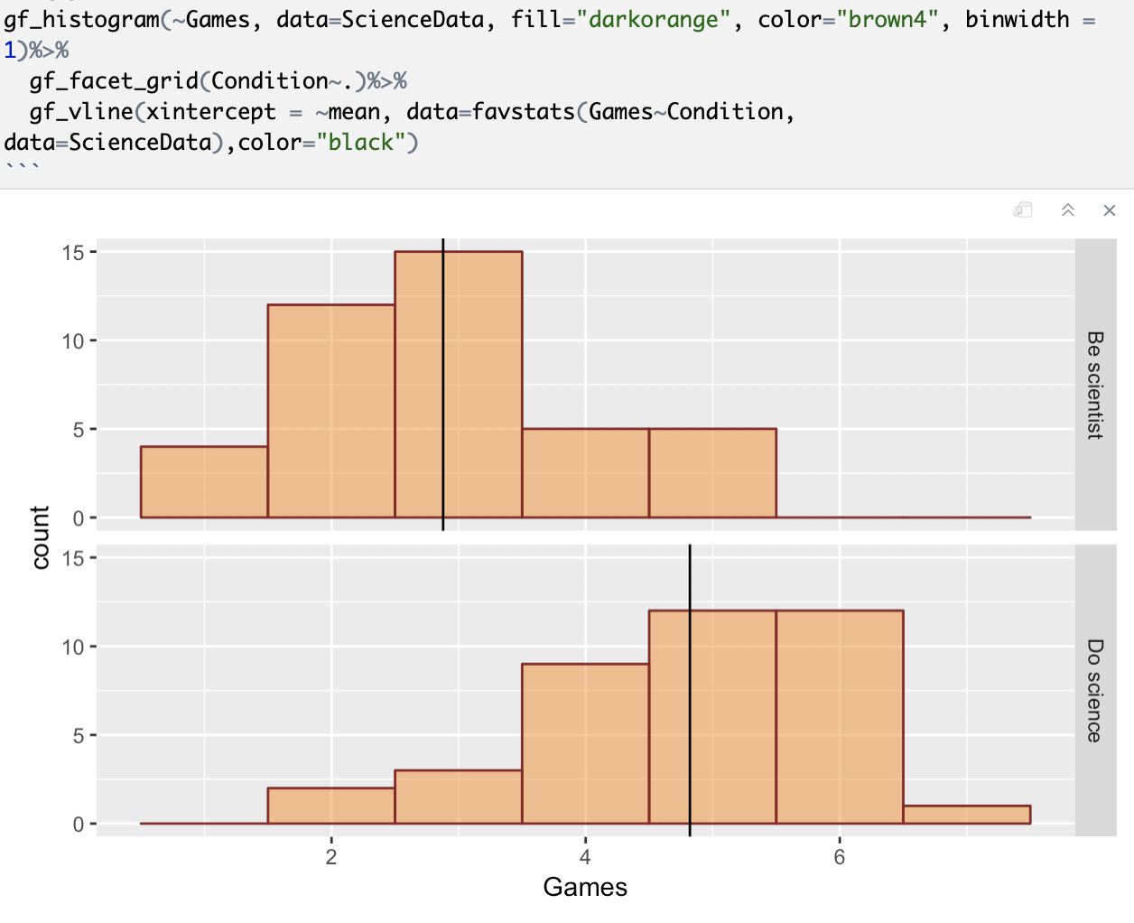
Rhodes 2019 Results

Slide 7
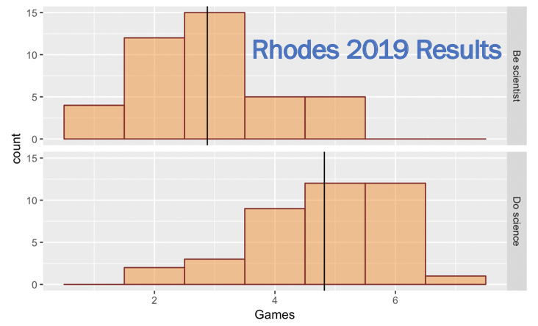
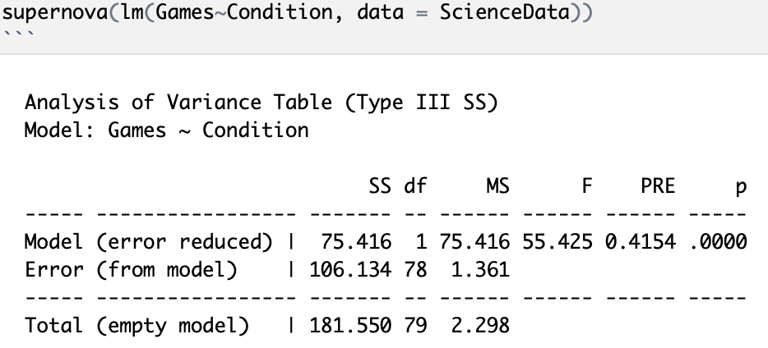


Slide 8
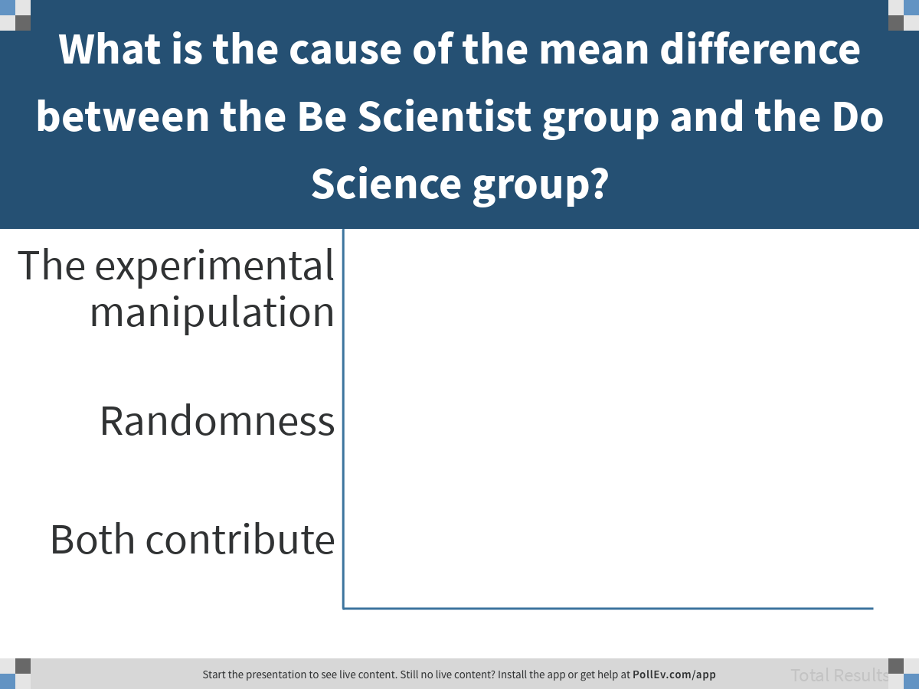
Notes:
What is the cause of the mean difference between the Be Scientist group and the Do Science group?
https://www.polleverywhere.com/multiple_choice_polls/iiydhnCoUlBz0tSPRh4RD

Slide 9
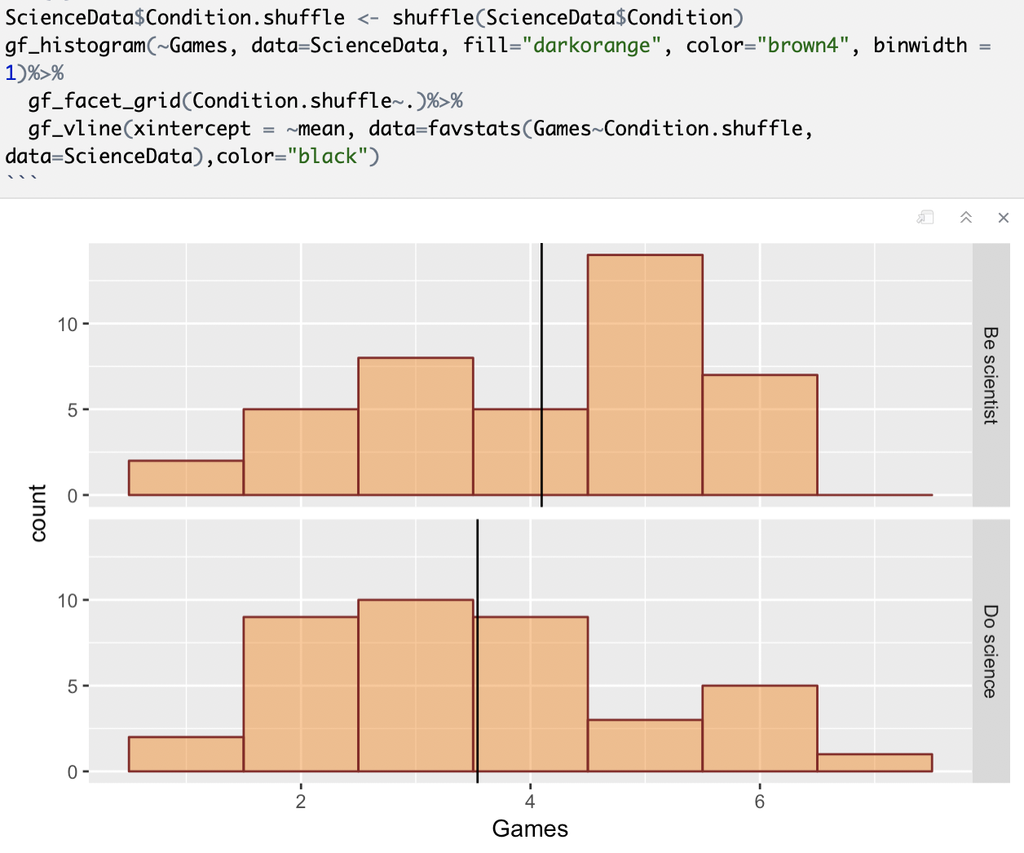
Rhodes 2019 Shuffled

Slide 10
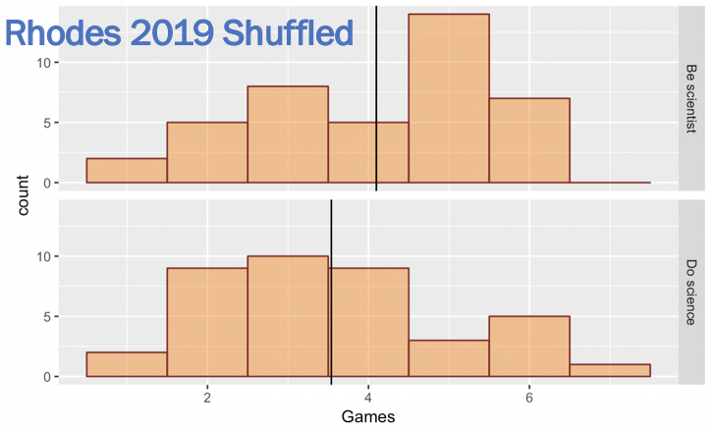
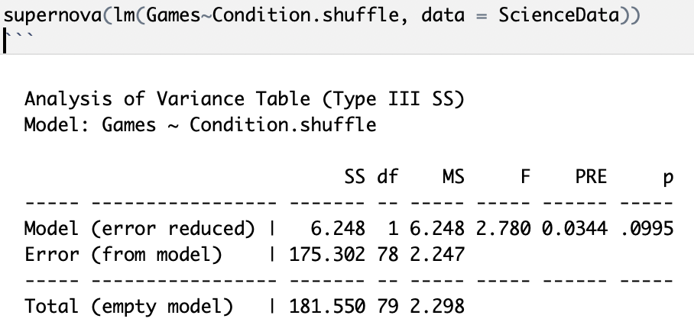

Slide 11
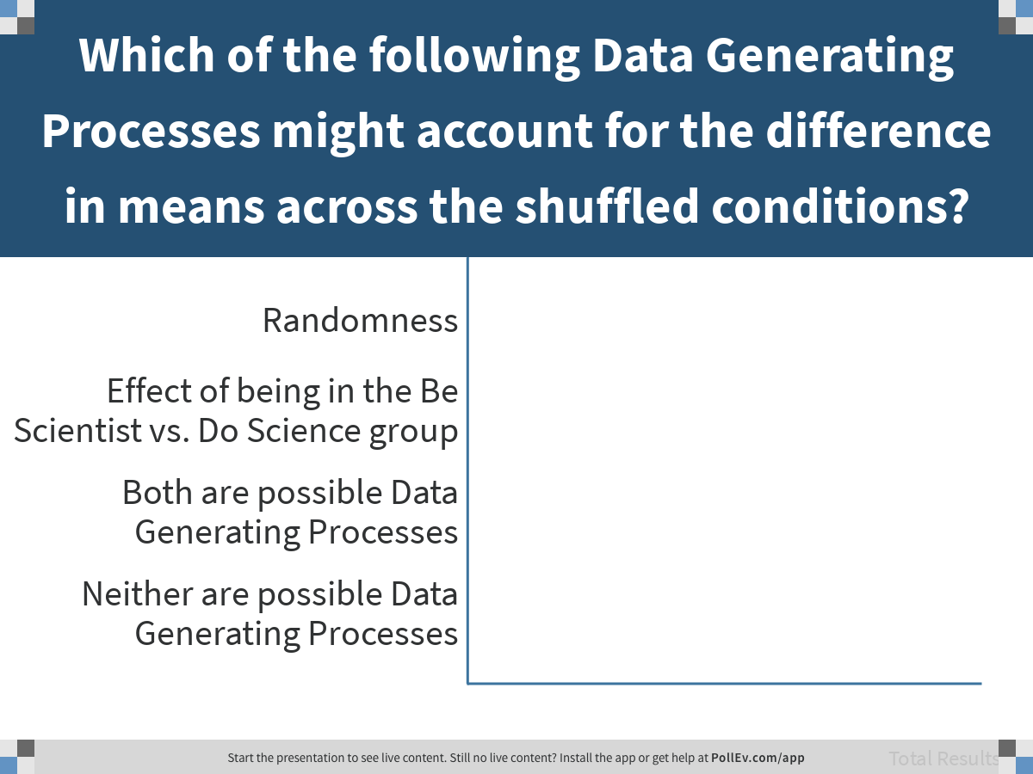
Notes:
Which of the following Data Generating Processes might account for the difference in means across the shuffled conditions?
https://www.polleverywhere.com/multiple_choice_polls/YRUi6HCZQIsRhku7kvWgm

Slide 12
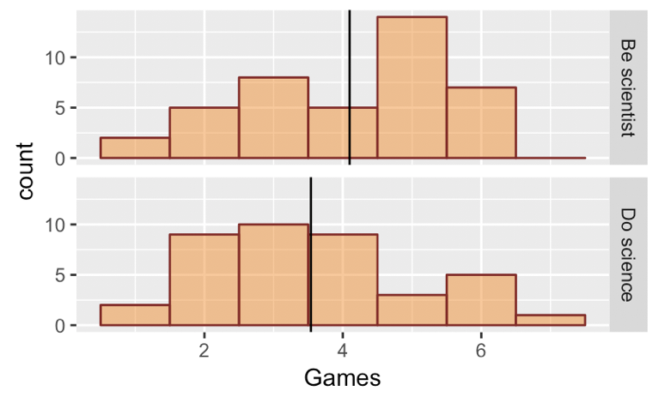
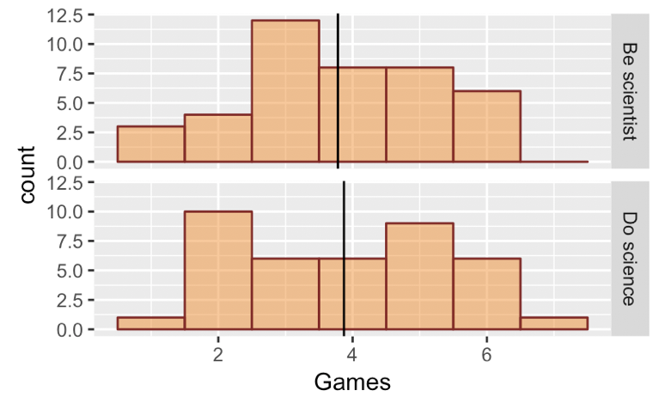
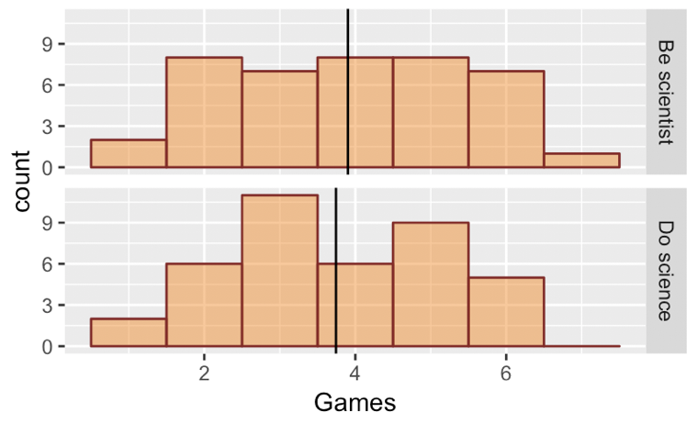
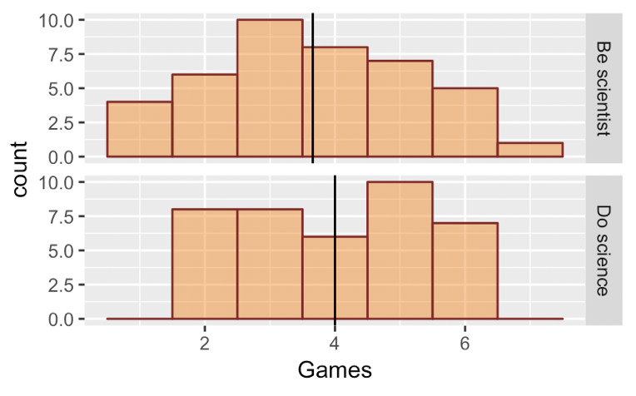
4 Shuffles: Why does Be Science do better in upper left?
What statistic could we use to summarize each shuffle?

Slide 13
What is a Sampling Distribution?

Slide 14
A sampling distribution is a distribution of sample statistics,
or estimates.

Slide 15
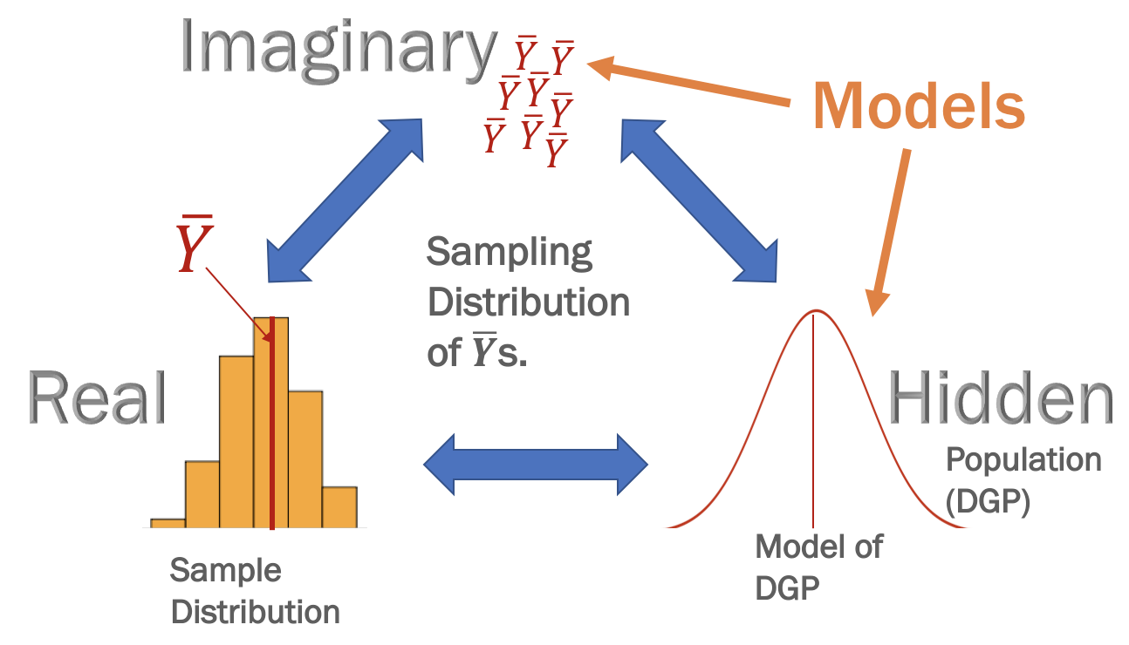
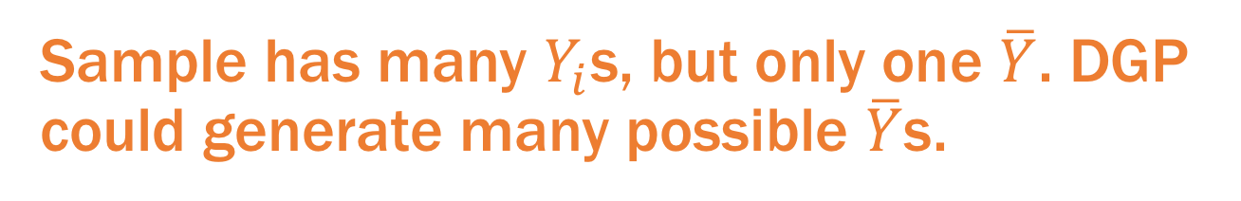
Distribution Triad: What Distribution do Sample Statistics (Estimates) Come From?
Sample has many $Y_{i}$s, but only one $\overline{Y}$. DGP could generate many possible $\overline{Y}$s.
Notes:
What is a statistical model? How does it fit with other psychology models?
We have theories...
But most of them are probabalistic...
A statistical model is a way to
Explain variation
Estimate the parameters of the DGP
Quantify how far off our estimates might be
Rule out chance variation in sampling as an explanation

Slide 16
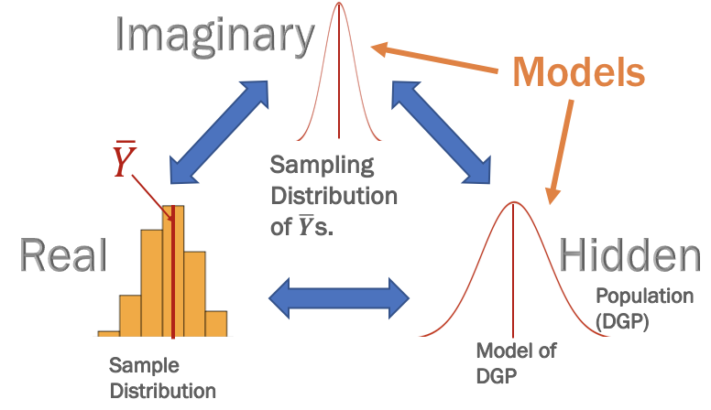
Distribution Triad: What Distribution do Estimates Come From?
Sampling distribution is a model of the distribution of estimates.
Notes:
What is a statistical model? How does it fit with other psychology models?
We have theories...
But most of them are probabalistic...
A statistical model is a way to
Explain variation
Estimate the parameters of the DGP
Quantify how far off our estimates might be
Rule out chance variation in sampling as an explanation

Slide 17
Why We Need a Sampling Distribution

Slide 18
A sampling distribution provides
the context for interpreting a sample statistic (parameter estimate).

Slide 19
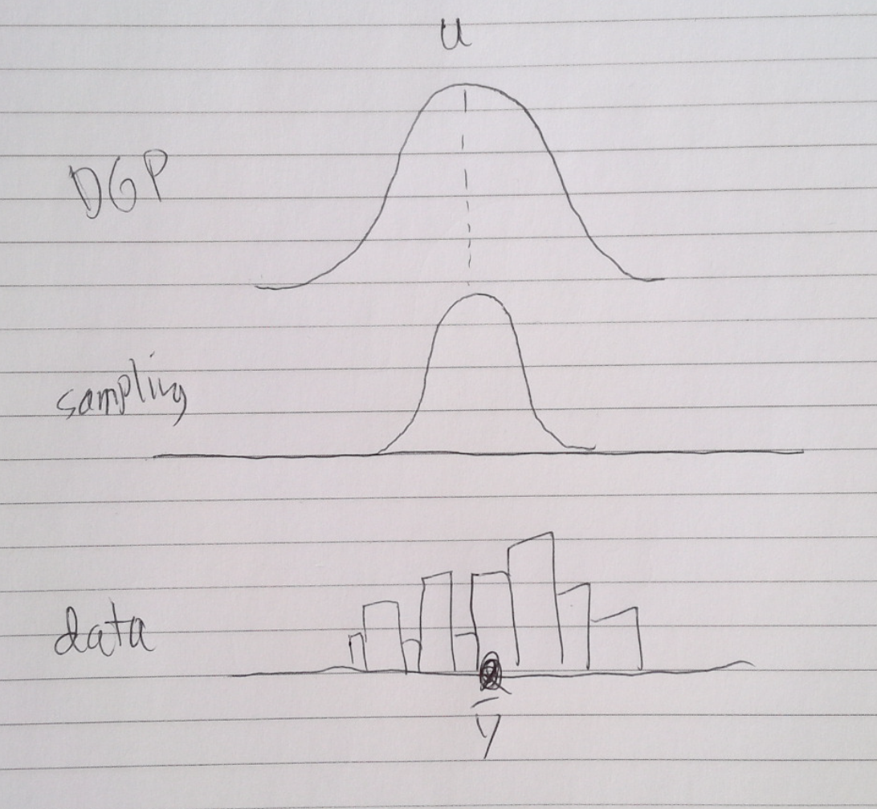
Draw Pictures
What kind of questions require model of DGP vs. sampling distribution?

Slide 20
Sample distribution provides context for interpreting single score
Your state had a score of 15.7% on FiveVegetables. How do we interpret that number?

Slide 21
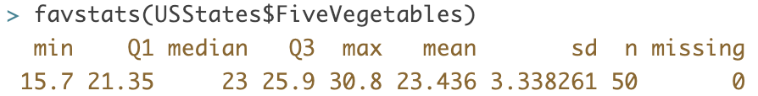
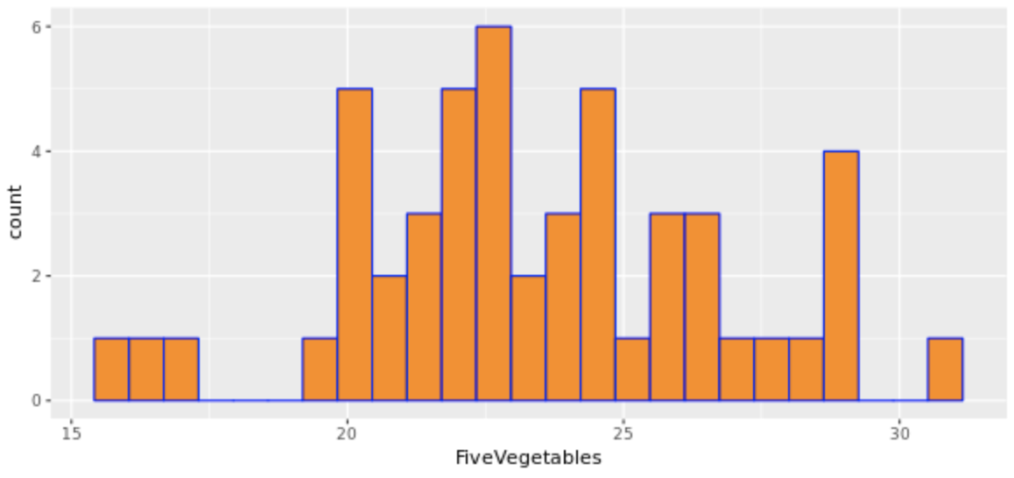
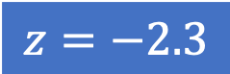
Sample distribution provides context for interpreting single score
Your state had a score of 15.7% on FiveVegetables. How do we interpret that number?
Sample distribution provides context for interpreting individual score.
$$z=−2.3$$

Slide 22
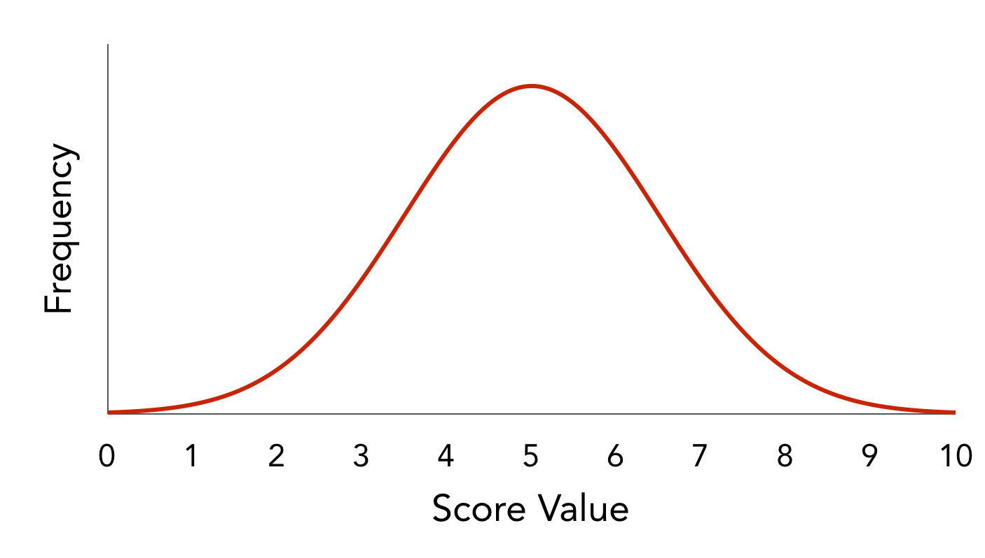

Sampling distribution provides context for interpreting sample statistic (parameter estimate)
You observed a mean of 23.4 on FiveVegetables in your study. How do we interpret that number?
$$\overline{Y}=23.4$$
?
?
?
23.4
Although we collected a distribution of scores, we only have one mean. We need to know what distribution that mean comes from.

Slide 23
How accurate is our parameter estimate?
?
?
?
23.4
Our sample was drawn from the DGP, but how off could our estimate be? How much error could there be in our estimate because of sampling variation?
Real
Hidden
Population
(DGP)
Model of DGP
Sample
Distribution

Slide 24
Distribution Triad: What Distribution do Estimates Come From?
Sampling distribution is a model of the distribution of estimates.
Notes:
What is a statistical model? How does it fit with other psychology models?
We have theories...
But most of them are probabalistic...
A statistical model is a way to
Explain variation
Estimate the parameters of the DGP
Quantify how far off our estimates might be
Rule out chance variation in sampling as an explanation

Slide 25
Any parameter estimate can be thought of as coming from a sampling distribution of all possible samples of the same size that could have been drawn from the same DGP.

Slide 26
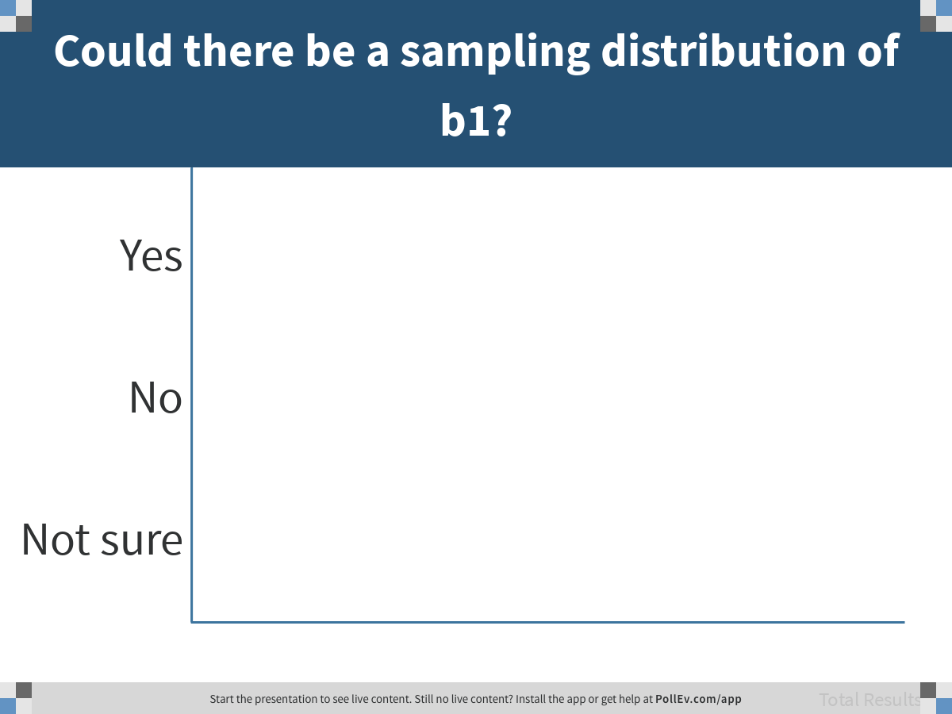
Notes:
Could there be a sampling distribution of b1?
https://www.polleverywhere.com/multiple_choice_polls/ztxlPoYeGOElCPi82EC7g

Slide 27
We have a number of ways to model sampling distributions:
With R:
Simulation (rnorm)
Randomization (shuffle)
Bootstrapping (resample)
Mathematical models

Slide 28
Constructing a Sampling Distribution of b1

Slide 29
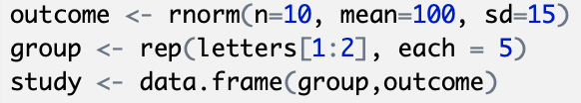
What does this code do?
Try running it…

Slide 30
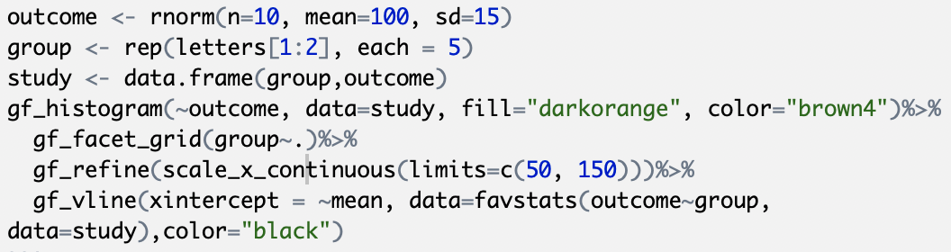
What does this code do?
Try running it…

Slide 31
Simulation:
Exploring the random DGP
(notice the jiggle)

Slide 32
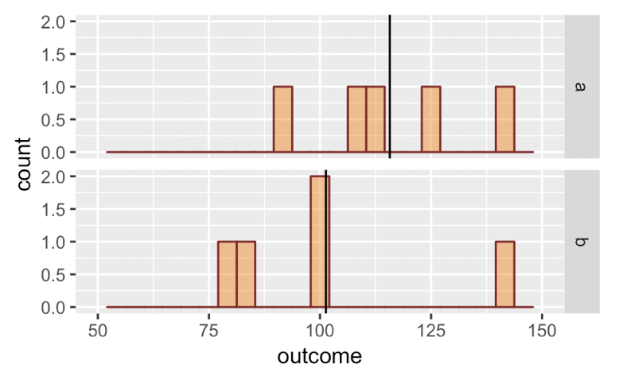
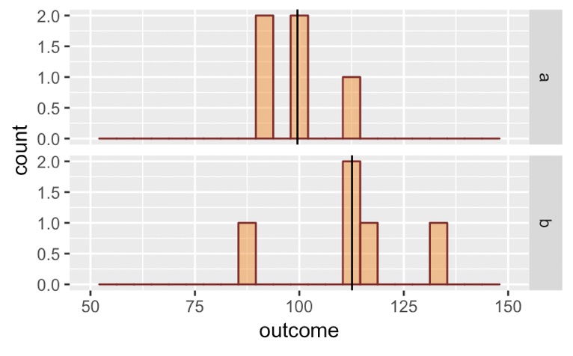
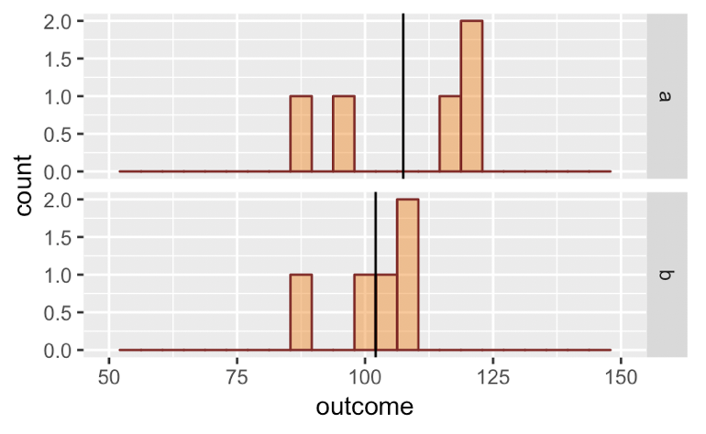
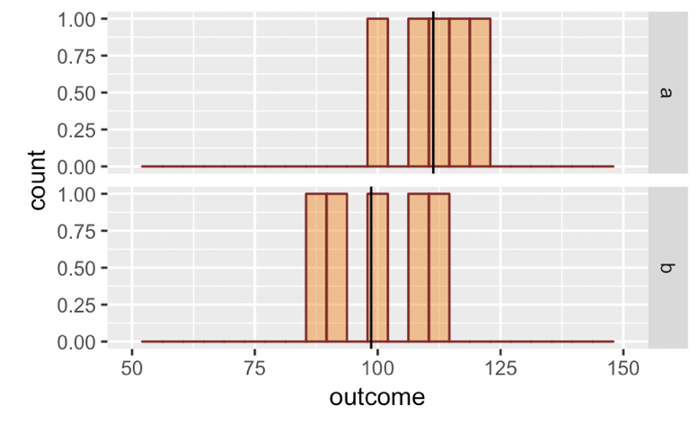
4 simulations: Why does group a do better in 3 of 4 cases?

Slide 33
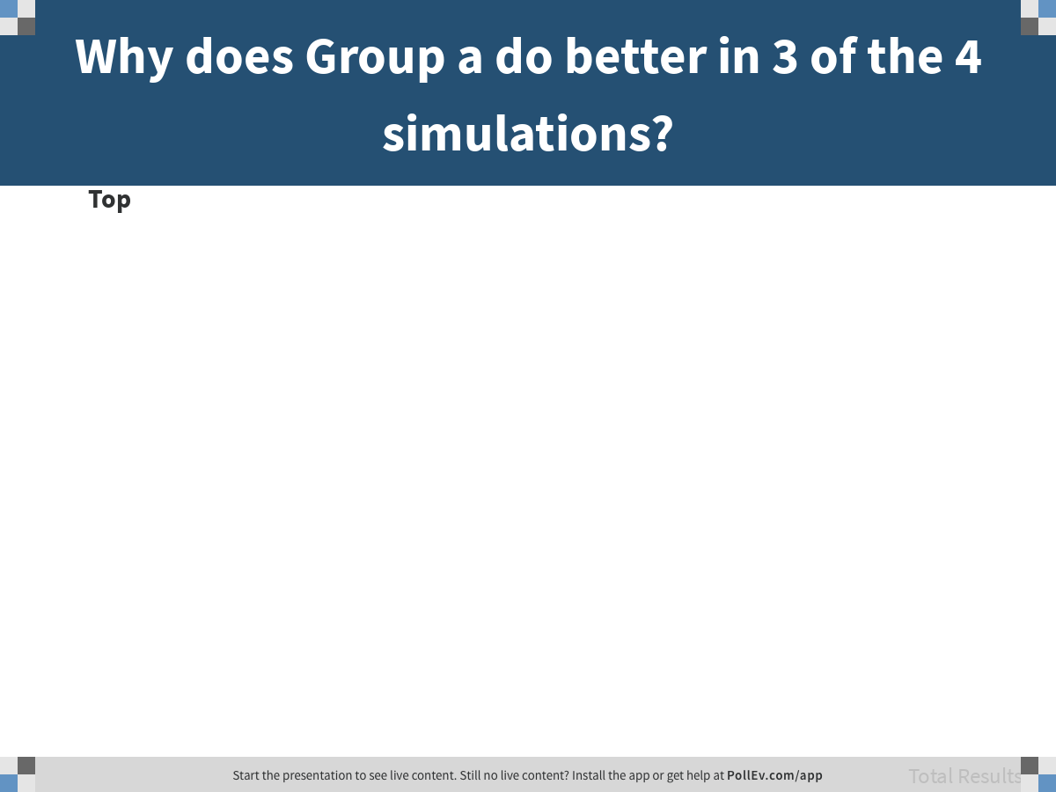
Notes:
Why does Group a do better in 3 of the 4 simulations?
https://www.polleverywhere.com/discourses/jRbJnAcobUlRlwa6Tn8ni

Slide 34
4 simulations: Why does group a do better in 3 of 4 cases?
What statistic could summarize the result of each simulation?

Slide 35
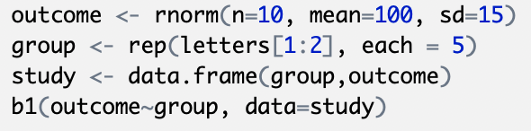
Add a line of code to get b1
Try running it…

